Slide 1
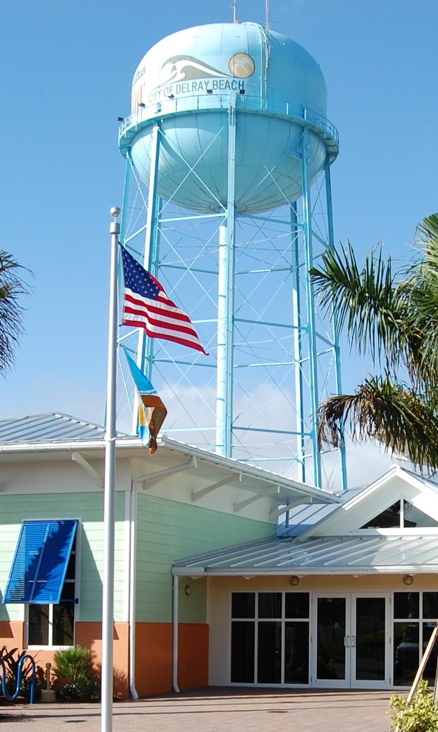
RESIDENTIAL CUSTOMER
MONTHLY WATER/SEWER RATES
Revised October 1, 2024
100 NW 1ST AVENUE, DELRAY BEACH, FLORIDA 33444
Water Rates | Inside City Limits | Outside City Limits
Fixed Customer Charge (Per Meter) | $3.00 | $3.75
Fixed Capacity Charge (Per Unit) | $13.57 | $16.96
Total Base Charges | $16.57 | $20.71
Water Usage Fees (added to base charge) Commodity charge: all meter consumption per 1,000 gallons | Inside City Limits | Outside City Limits
Zero to 3,000 gallons | $2.03 | $2.54
3,001 to 12,000 gallons | $2.03 | $2.54
12,001 to 25,000 gallons | $4.06 | $5.08
25,001 to 50,000 gallons | $6.09 | $7.61
Above 50,000 gallons | $8.12 | $10.15
Sewer Fees (maximum commodity charge of 12,000 gallons per unit) | Inside City Limits | Outside City Limits
Fixed Capacity Charge (Per Unit) | $18.04 | $22.55
Fixed Commodity Charge (Per Unit) | $ 3.72/1,000 gal up maximum of 12,000 gal | $ 4.65/1,000 gal
NOTE: Fixed/Base charges are applicable each and every month, without regard to usage or occupancy.
City of
Delray Beach
Utility Billing Division
Utility Billing Division
100 NW 1st Avenue Delray Beach, Florida 33444
561-243-7101

Slide 2
UTILITY BILLING CUSTOMER SERVICE INFORMATION
Our Mission:
The City of Delray Beach Utility Billing Division has a commitment to provide our water/sewer and sanitation customers with courteous and efficient service at all times as we strive toward our ultimate goal of total customer satisfaction. We are responsible for servicing over 22,532 utility accounts in Delray Beach.
Our customer service representatives are available to answer your questions each business day between 8:00 am and 5:00 pm in our lobby office in City Hall.
W A T E R / S E W E R S E R V I C E
How to Start Your Service:
A DEPOSIT must be received prior to the initiation of utility service for each service location regardless of good credit history. To register for new service, please email your signed application with required documentation to utilitiescustomerservice@mydelraybeach.com . Deposit amounts vary according to meter sizes as follows:
SINGLE FAMILY- MULTI FAMILY - COMMERCIAL/IRRIGATION
Meter Size Inside City Outside City
Billing Remittance Advice:
Your bill is due upon receipt. If we receive payment within thirty (30) days of the billing date, you will avoid any delinquent penalties. If your payment is received after thirty (30) days a $5.00 late penalty will be assessed. If your account has a past due balance, you will receive a past due reminder notice. If you receive a past due reminder notice, payment must be received within eighteen (18) days to avoid service disconnection. If your service has been disconnected for non-payment, payment of the entire balance due on your account plus any late penalties and reconnection charges must be received by our office before we can schedule the reconnection of your service.
3/4” | $100.00 | $125.00
1” | 100.00 | 125.00
1 1/2” | 150.00 | 187.50
2” | 175.00 | 218.75
3” | 200.00 | 250.00
Water service can be connected the same day. If an account is canceled and service is resumed, the customer will be back-billed for all utility service for each and every month the utility service was discontinued.
Service Charges:
$15.00 service charge is assessed to each new account regardless of any previous account(s).
$20.00 service charge is assessed to each account that has been discontinued due to non-payment OR if the customer’s name appears on the Non-Payment Disconnection Listing which is distributed internally.
$20.00 service charge is assessed to each account for a returned check.
$40.00 after-hour service fee will be charged for requests to have water turned on after regular working hours.
$15.00 charge will be assessed for each meter re-read if requested by the customer in excess of three such requests in one month.
Payment Options:
Customers may drop their payments in our 24-hour night depository located in front of City Hall.
Customers may also pay by credit card via the telephone system (561-243-7100) or the Internet at www.delraybeachfl.gov (I WANT TO/Pay Online/Utility Bills).
Customers are requested to mail payments to:
City of Delray Beach PO Box 288242
Tampa, Florida 33630-8242
GARBAGE and TRASH COLLECTION INFORMATION
Waste Management Inc. of Florida contracted to collect the garbage, trash and recycling for the City of Delray Beach. Charges are applicable each and every month without regard to usage or occupancy. For information on collection days, visit our website or contact Code Enforcement at 561-243-7219.
YOUR CONSIDERATION IS APPRECIATED!
REMEMBER THAT IT IS THE CUSTOMER’S RESPONSIBILITY TO ENSURE THE WATER METER REMAINS ACCESSIBLE AT ALL TIMES TO CITY STAFF FOR READING AND REPAIRS.
Garbage and Trash Collection Rates
Residential Reclaimed Water Rates
Service Type | Description | Rate
A C D | Roll Out Carts Curbside Disposable Containers Multi-Family | $19.13 $19.13 $14.38
Gallons | Charge per 1,000 Gallons
All Consumption | $1.00

